Slide 1


Group Project – Oasis Team
Kings College London
Module Tutor – Dr. Laurent Tratt
Tehao Ye
Mohan Chi
Yibo Liu
Zhihao Zhu
Jiawei Zhou
Yankai Chen
Jiawei Ding

Slide 2

catalogue
1
1
3
3
Project Architecture
Timetable
2
4
2
4
Project Organization
Demo

Slide 3
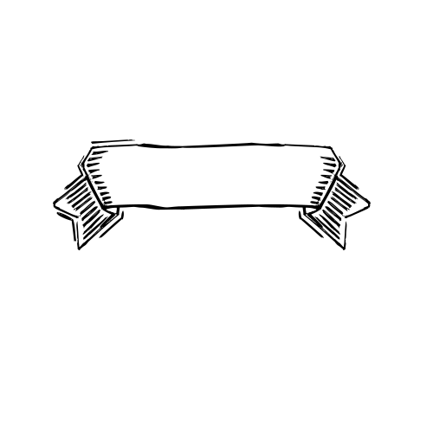
yanchi
1 Project Architecture

Slide 4
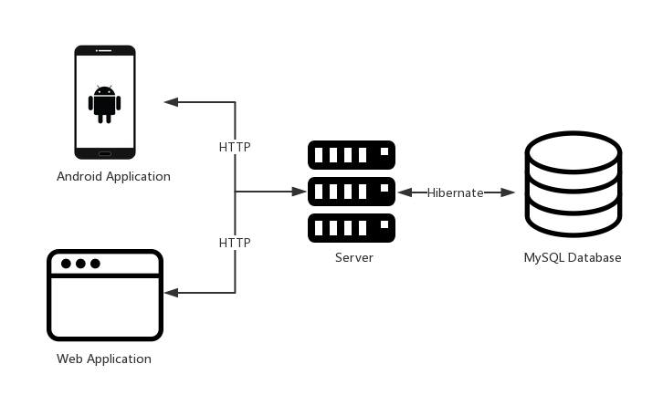
1 Project Architecture
In order to implement the Android application and web application for this project, we design the software architecture as Figure 1. HTTP protocol will be used both for Android application and web application to download and upload files. For the Android application, its design and implementation will follow the Material Design. For the web application, Bootstrap and Angular will be used for front-end development, and Spring MVC will be applied to back-end development, Hibernate will be used as a persistent tool for the MySQL database.

Slide 5
yanchi
2 Project Organization

Slide 6
2 Project organization
Android App
Design and Implementation | Tehao Ye, Yankai Chen
Desktop App
Front-end | Yibo Liu, Mohan Chi, Jiawei Ding
Back-end | Zhihao Zhu, Jiawei Zhou

Slide 7
3 Timetable

Slide 8
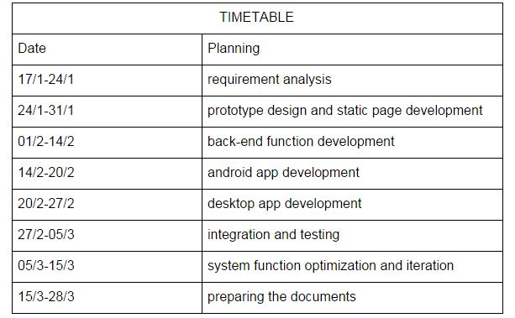
3 Project Timetable

Slide 9
4 Demo

Slide 10
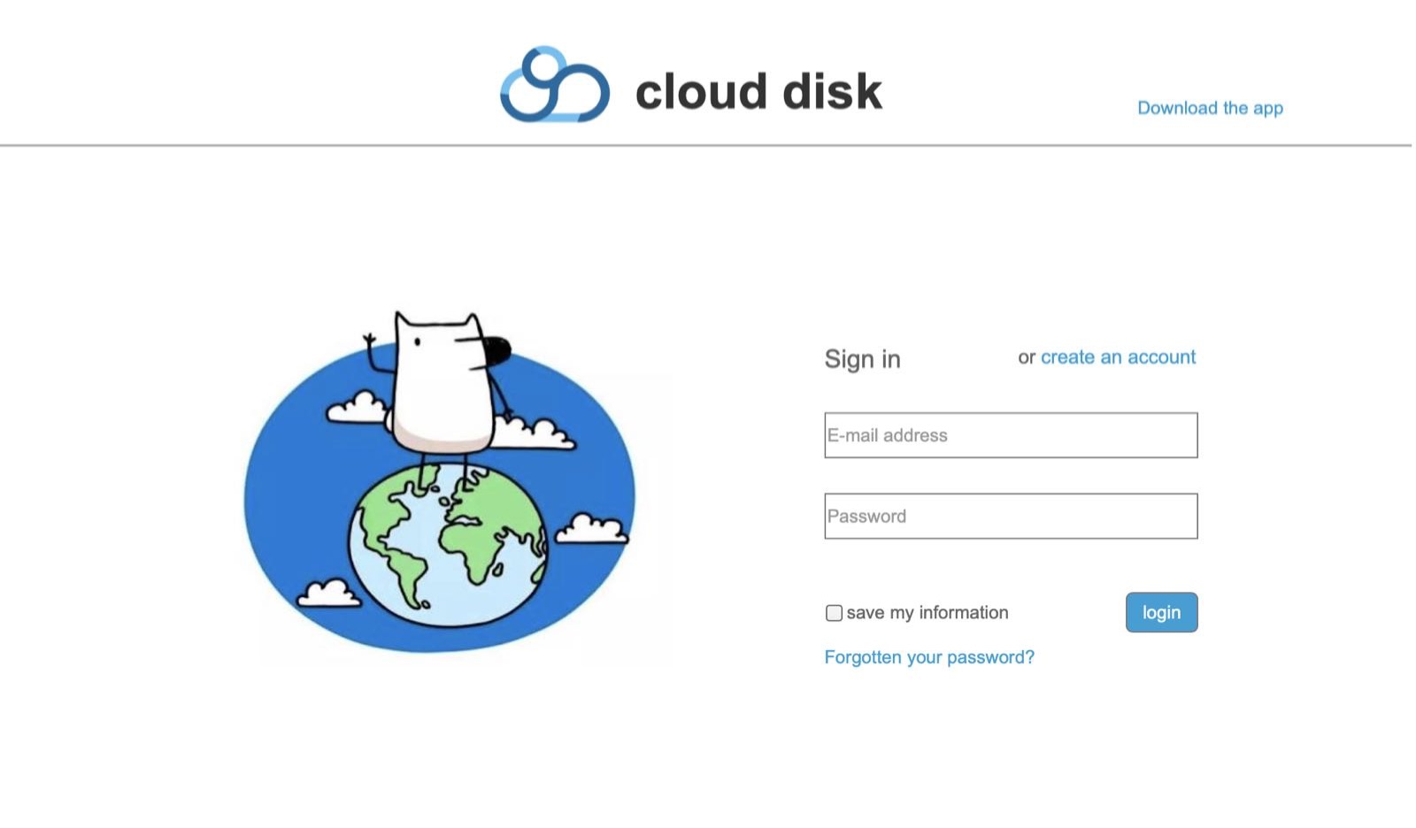
Desktop interface：

Slide 11
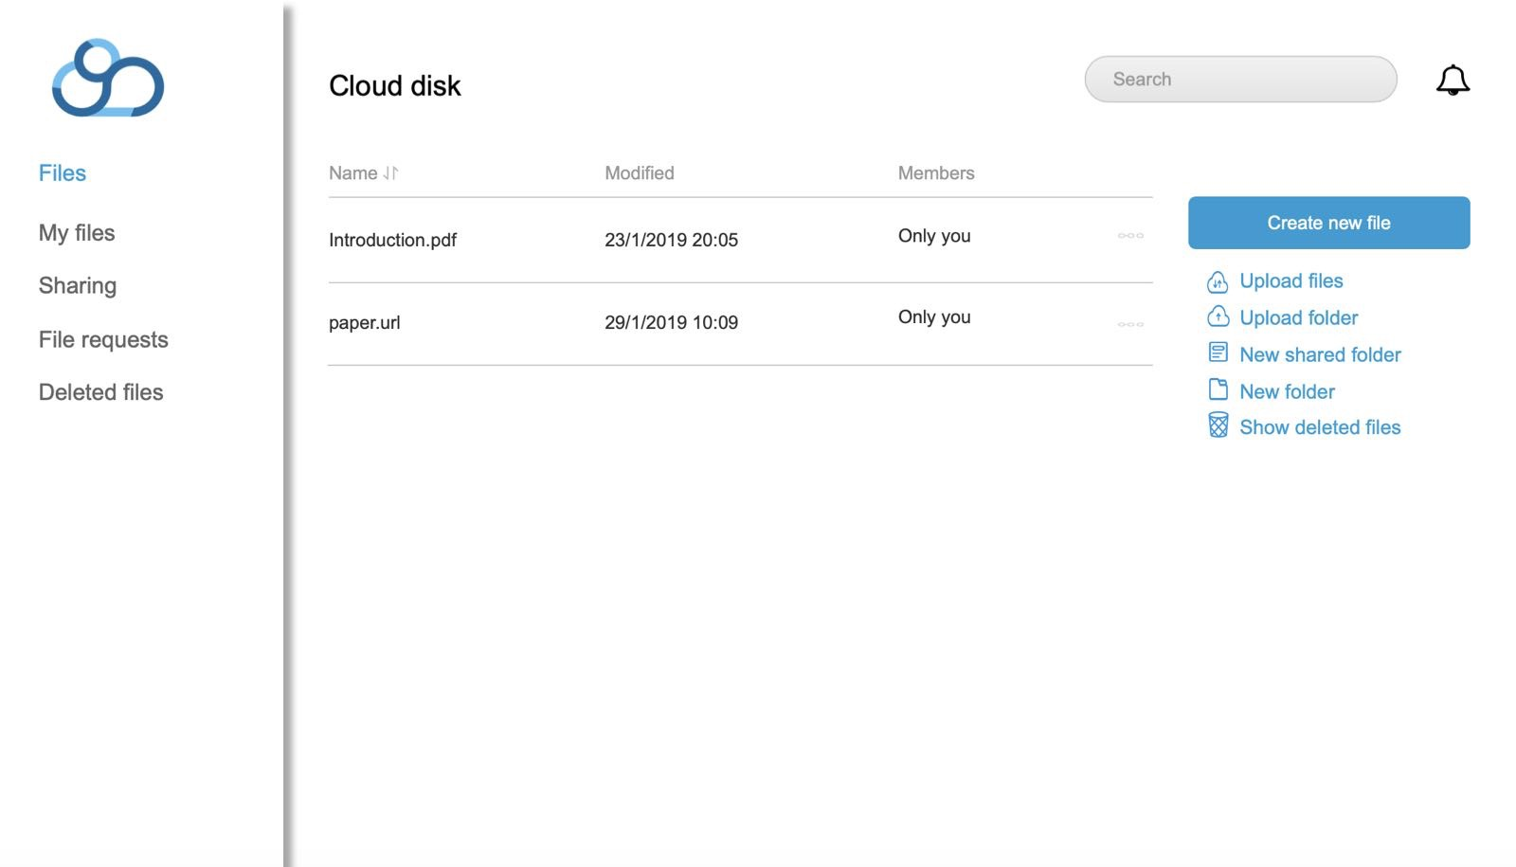
Desktop interface：

Slide 12
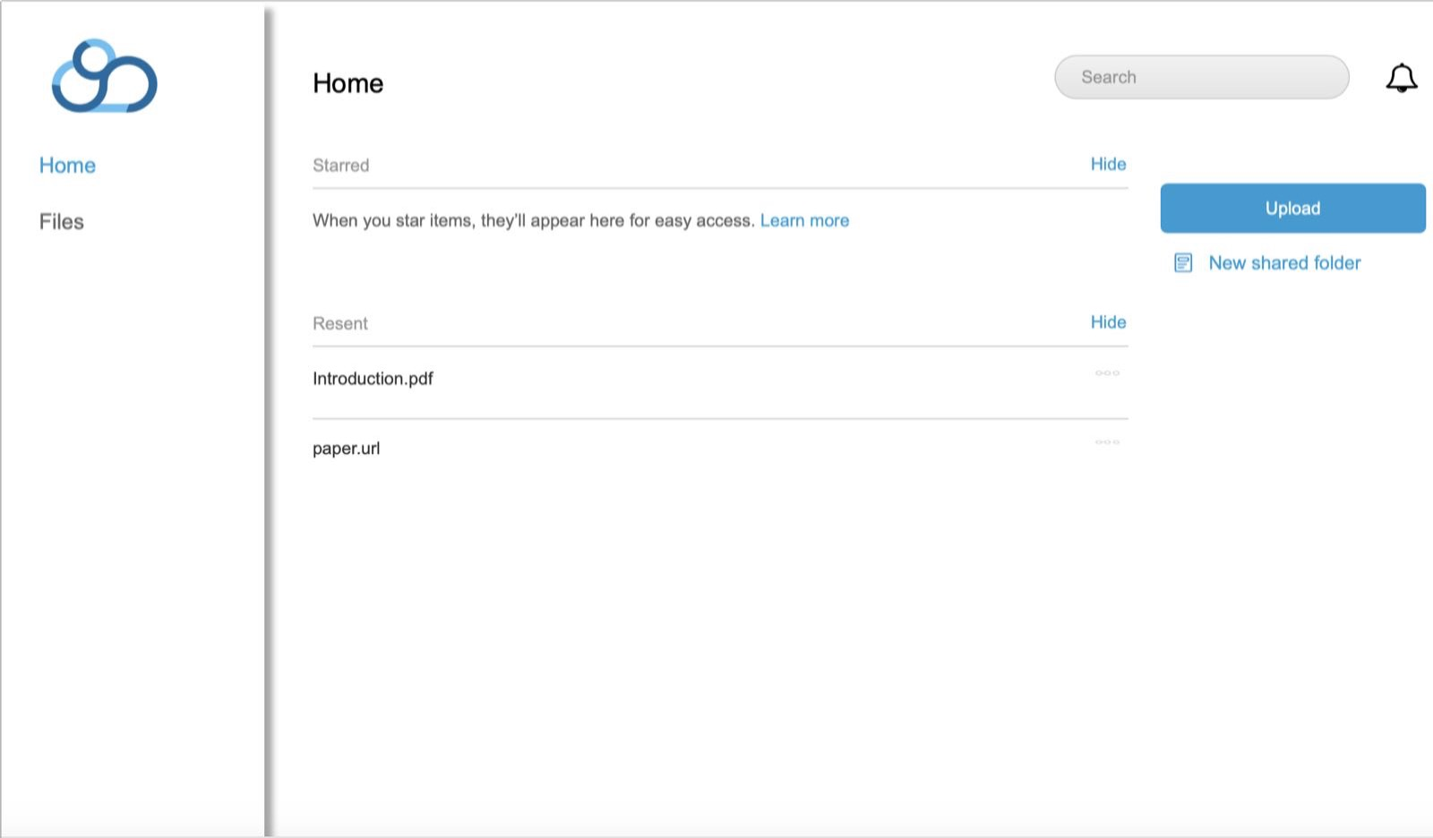
Desktop interface：

Slide 13
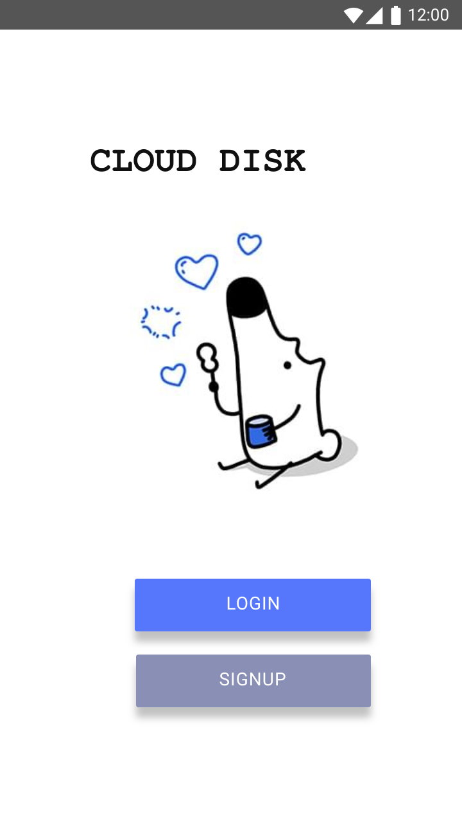
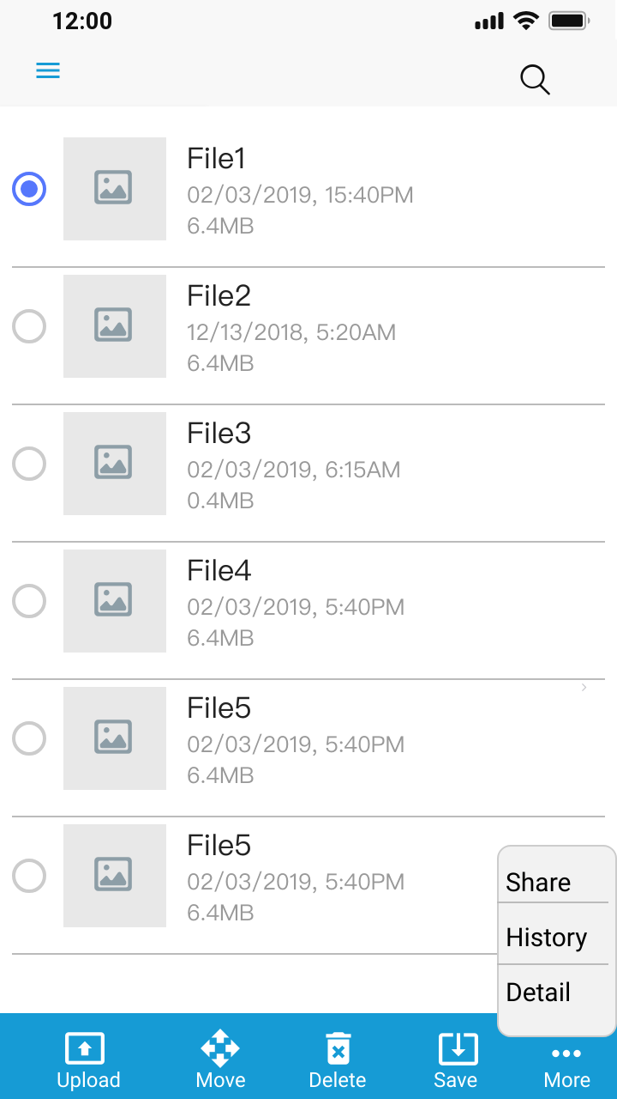
Android interface：

Slide 14
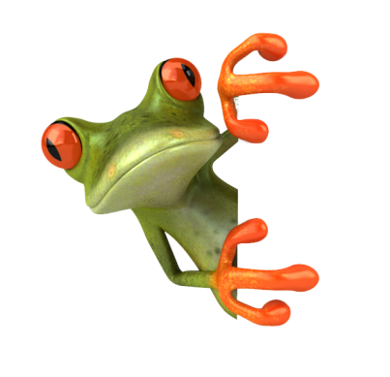

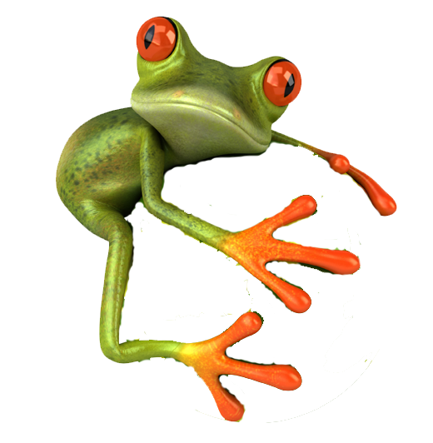
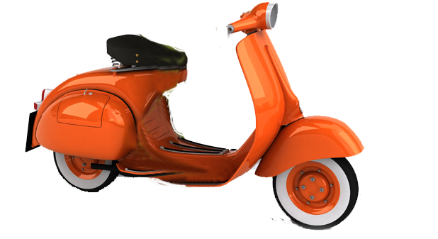
THANKS!

